Slide 1
Immune System: organization of cells and molecules with specialized roles in defending the body against infection
Immune System Involves:
1st: Recognition of pathogen or foreign matter
2nd reaction to eliminate it
Specificity: distinguish against non-cross-reacting antigens
Memory: quicker and more vigorous response to pathogen invasion
Mobility: local rxn to systemic protection
Replicability: amplify immune system

Slide 2
Innate response
Phagocytic cells
Macrophages/Monocytes
Neutrophils
Inflammatory mediators
Basophils/Mast Cells
Eosinophils
Natural killer cells
Presents Antigen
Tx bacteria & fungus
Anaphylaxis/angioedema
Parasites/allergy
Tumors
Notes:
Innate response
Phagocytic cells
Macrophages/Monocytes
Presents Antigen
Neutrophils
Tx bacteria & fungus
Inflammatory mediators
Basophils/Mast Cells
Anaphylaxis/angioedema
Eosinophils
Parasites/allergy
Natural killer cells
tumors

Slide 3
Adaptive Response
Humoral Immunity
B cells (a WBC)
IgM
quick onset
IgG
allergy
Cell mediated immunity
T Cells (WBC)
Helper T cells (CD4)
Cytotoxic T cells
Suppressor T cells
Down regulate immune
Transplants
T helper 1 = cytotoxic
T helper 2 =
make antibodies
CD4 is a glycoprotein found on the surface of immune cells such as: T cells and macrophages/monocytes
T cells release cytokines
Cytokines are agents used for cell signaling such as interleukins (IL) and interferons
Notes:
Adaptive Response
Humoral Immunity
B cells
IgM (quick onset)
IgG (allergy)
Cell mediated immunity
T cells
CD4 (helper T)
Interleukins
CD8 (suppressor cells)

Slide 4
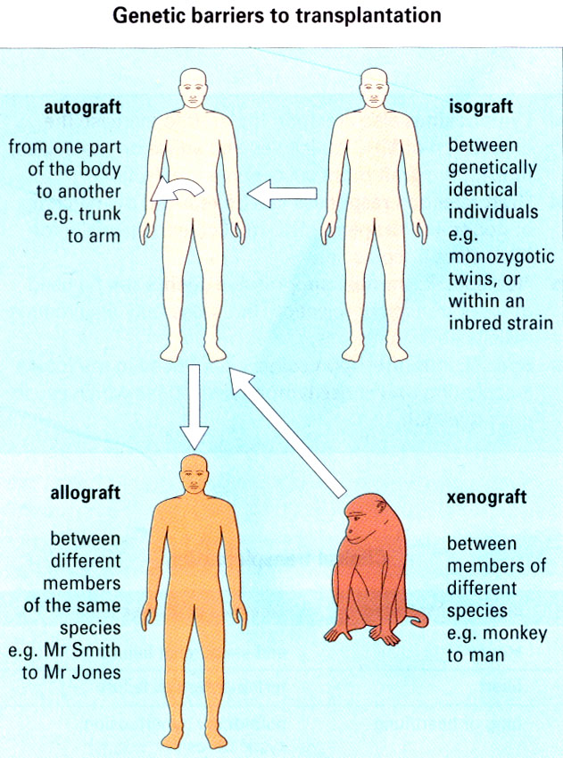
Major Histocompatability Complex (MHC)
Molecule on cell mediate interactions with immune cells
MHC Genes
Genetically similar tissue is said to be histocompatible
(safe transplant)
MHC haplotypes are from both parents
Allograft =
Histocompatible

Slide 5
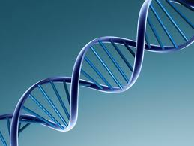
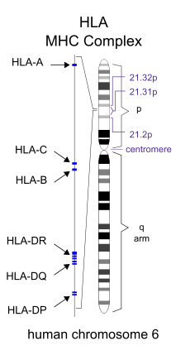
MHC Classes
Class 1 Gene
found on cells & platelets
Class 2 Gene
found on B cells, macrophages/monocytes
Class 3 Gene
HLA-A
HLA-B
HLA-C
HLA-DP
HLA-DQ
HLA-DR
Code for TNF
These genes play a central role in the initiation of the immune response to transplantation antigens.
The human leukocyte antigen (HLA) system is the name of the major histocompatibility complex (MHC) in humans

Slide 6
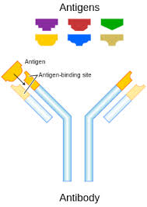
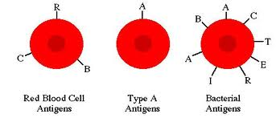
ABO Blood System
The nomenclature of the ABO system is based on which antigen is present on an individual’s RBC
O Is Universal Donor
AB is Universal Acceptor
Blood group | Antigen on RBC | Antibody in serum
A | A | β
B | B | α
AB | Both A and B | Neither a nor b
O | Neither A nor B | Both a and b

